Slide 1
US Economic Indicators Relationship to SPY Performance

Slide 2



Our Team
Finn Ihlanfeldt
Mateo Tamarozzi
Owen Merrill

Slide 3



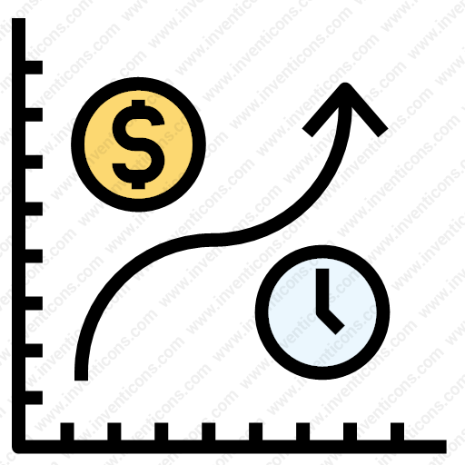
Research Question & Agenda
Do these U.S. economic indicators have a statistical or predictive relationship with monthly SPY returns?
Macro economic indicators used
Agenda
Notes:
Agenda
Talk about where we got data from (FRED and SPY)
The steps we took and different ways we tested the data through different regressions
Compare results from those tests
Then our conclusion
Then any questions you may have

Slide 4
Steps we took
Downloading Data and Exploratory Data Analysis (EDA)
Indicator Lagging and Feature Engineering
Single Variable Regressions
Multivariable Regression
Rolling Window Analysis
Granger Causality Tests
Relationships and Conclusions
Notes:
Downloading Data and Exploratory Data Analysis-
Imported libraries: Yfinance, Pandas, Numpy, MatPlotLib, Seaborn, StatsModels.API.
Defined Macro variables, and downloaded macro data from FRED
Download SPY monthly returns and calculated those returns
Indicator Lagging and feature engineering—effects of these indicators are not instantaneous to market outcomes
Did this to see if using past data can help us predict future market returns
Rolling Window Analysis-Shows economic relationships are not constant, helped us track changes over time
We used a 24 month rolling window
Focused on how sensitive SPY returns were to each macro variable
Granger Casuality Tests- to test predictability
time series test to see whether past values of an indicator help predict future SPY returns

Slide 5
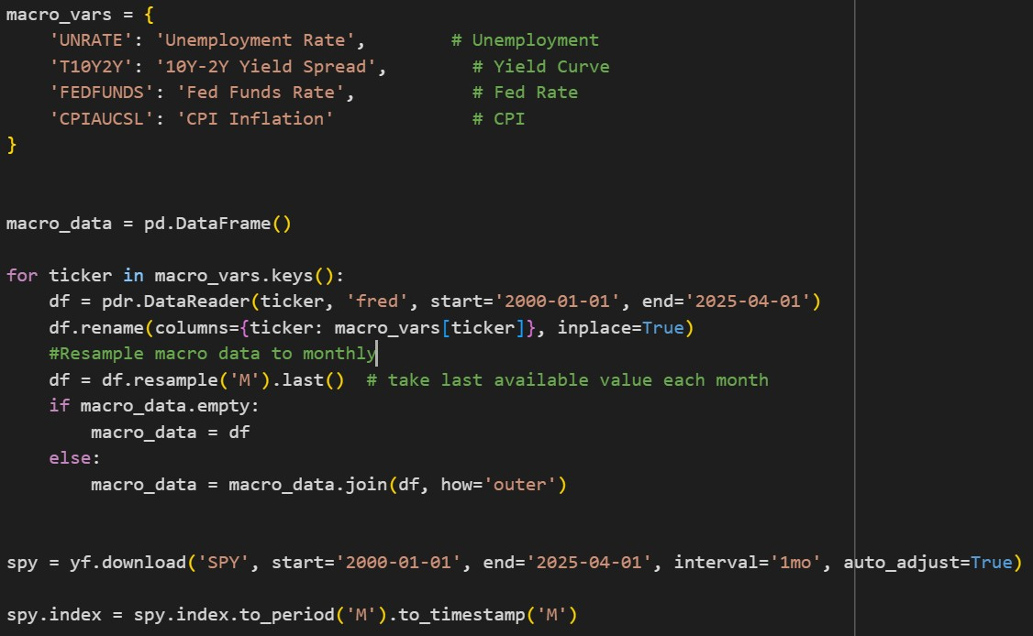
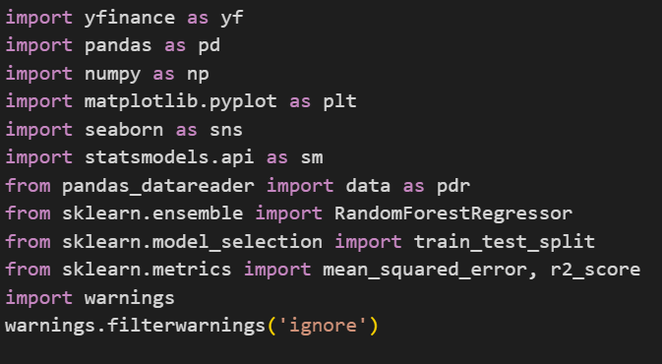
Downloading Data & Exploratory Data Analysis (EDA)
Date | Unemployment Rate | 10Y-2Y Yield Spread | Fed Funds Rate | CPI Inflation | SPY Returns
2/29/2000 | 4.1 | -0.11 | 5.73 | 170 | -0.0152
3/31/2000 | 4 | -0.47 | 5.85 | 171 | 0.0941
4/30/2000 | 3.8 | -0.45 | 6.02 | 170.9 | -0.0327
5/31/2000 | 4 | -0.4 | 6.27 | 171.2 | -0.0157
6/30/2000 | 4 | -0.35 | 6.53 | 172.2 | 0.0173
Imported Libraries
Defined Macro Variables
Download SPY monthly returns
Cleaned Data
303 monthly observations
02/29/2000-04/30/2025
Notes:
Downloading Data and Exploratory Data Analysis-
Imported libraries: Yfinance, Pandas, Numpy, MatPlotLib, Seaborn, StatsModels.API.
Defined Macro variables, and downloaded macro data from FRED- Unemployment Rate, Yield Curve, Federal Funds Rate, CPI
Download SPY monthly returns and calculated those returns
Cleaned Data- by aligning timeframes(converted all data to monthly)

Slide 6
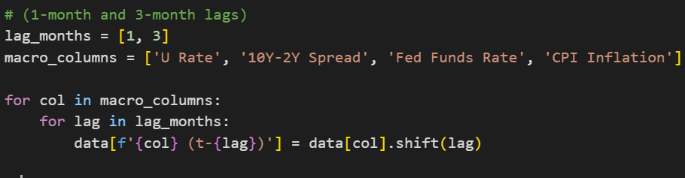
Indicator Lagging and Feature Engineering
Created Lagged macroeconomic features to capture delayed market responses
Built 1-month, and 3-month lags for each macro indicator
Purpose of Lagging
Avoid Lookahead Bias
Reflect that economic reports are released after the month ends.
Date | U Rate (t-1) | U Rate (t-3) | 10Y-2Y Spread (t-1) | 10Y-2Y Spread (t-3)
5/31/2000 | 3.8 | 4.1 | -0.45 | -0.11
6/30/2000 | 4 | 4 | -0.4 | -0.47
7/31/2000 | 4 | 3.8 | -0.35 | -0.45
8/31/2000 | 4 | 4 | -0.26 | -0.4
9/30/2000 | 4.1 | 4 | -0.45 | -0.35
Notes:
This a table of our variables: unemployment rate with a 1 month, and 3 month lag, the spread between the 10year and two year with 1 month and 3 month lag, etc.
In the real world, markets don’t instantly react to economic data, investors process and react over time. So lags are crucial
Unemployment and Yield Curve
Look ahead Bias
Happens when model or analysis uses future information that would not have been available at the time you were trying to make your prediction

Slide 7
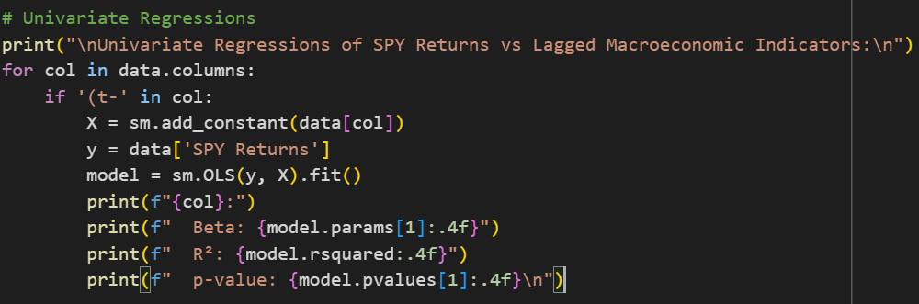
Single Variable Regression Model
 | Variable | Beta | R² | p-value
1 | Unemployment Rate (t-1) | 0.0026 | 0.0133 | 0.0458
2 | Unemployment Rate (t-3) | 0.0027 | 0.014 | 0.0409
3 | 10Y-2Y Yield Spread (t-1) | 0.0003 | 0 | 0.915
4 | 10Y-2Y Yield Spread (t-3) | 0.0004 | 0.0001 | 0.8864
5 | Fed Funds Rate (t-1) | -0.0017 | 0.006 | 0.1821
6 | Fed Funds Rate (t-3) | -0.0019 | 0.007 | 0.1473
7 | CPI Inflation (t-1) | 0.0001 | 0.0062 | 0.1741
8 | CPI Inflation (t-3) | 0.0001 | 0.0063 | 0.1703
Measured the significance of each variable on monthly SPY returns through
P-Values (relationship significance)
Beta (size & direction sensitivity to indicator)
R-Squared (explanatory power)
What does this all tell us?
Is this normal?
Notes:
Beta- Measures the size and direction of sensitivity. (>1 asset is more volatile than the market, <1 asset is less volatile than the market)
P-Value—Measures whether the relationship between the macro indicator is statistically significant. (considered significant if <.5)
R-Squared—How much of the SPY return variability this macro variable can explain.
What this tells us- SPY movements are driven by many simultaneous factors, not one macro variable
Results- It is normal to not find much significance while using single variables—You need multi-factor models to get a stronger prediction signal

Slide 8
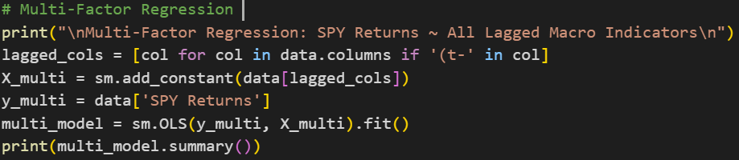
Multivariable Regression Model
Metric | Result
R² | 0.034
Adj. R² | 0.008
F-stat p-value | 0.244
Most p-values | > 0.4
Condition Number | 3840
Statistics
R^2 - SPY return variance explained by model
Adj. R^2- SPY return variance explained by the 8 predictors
F-stat p-Value >0.05 - High: model is not statistically significant
Individual p-values >0.4 – no single predictor is significant
Multicollinearity
Inter-Variable Codependence
SPY Returnst​=α+β1​×CPIt−1​+β2​×Unemploymentt−1​+β3​×FedFundst−1​+β4​×YieldCurvet−1​-ϵt
Notes:
R²- only 3.4% of SPY return variance is explained by this macro model
Adj. R² - Even less when adjusted for 8 predictors
(>0.05) The overall model is not statistically significant
The individual predictors do not collectively
(>0.4) No single predictor is significant in this multivariate setting – little to no linear relationship with response variable.
You fail to reject the null hypothesis that its coefficient is zero. Meaning:
The data does not provide sufficient evidence that the predictor is related to the response variable.
Hence, it likely has little or no explanatory power in the context of the model.
Poor P-Values can be explained by:
Error Condition Number:
Warning of multicollinearity (too much correlation between predictors)
Meaning that the predictor variables are not necessarily completely independent of one another.
Example:
Codependence – Think of Phillips Curve (direct short-run correlation between unemployment and inflation (trade-off).

Slide 9
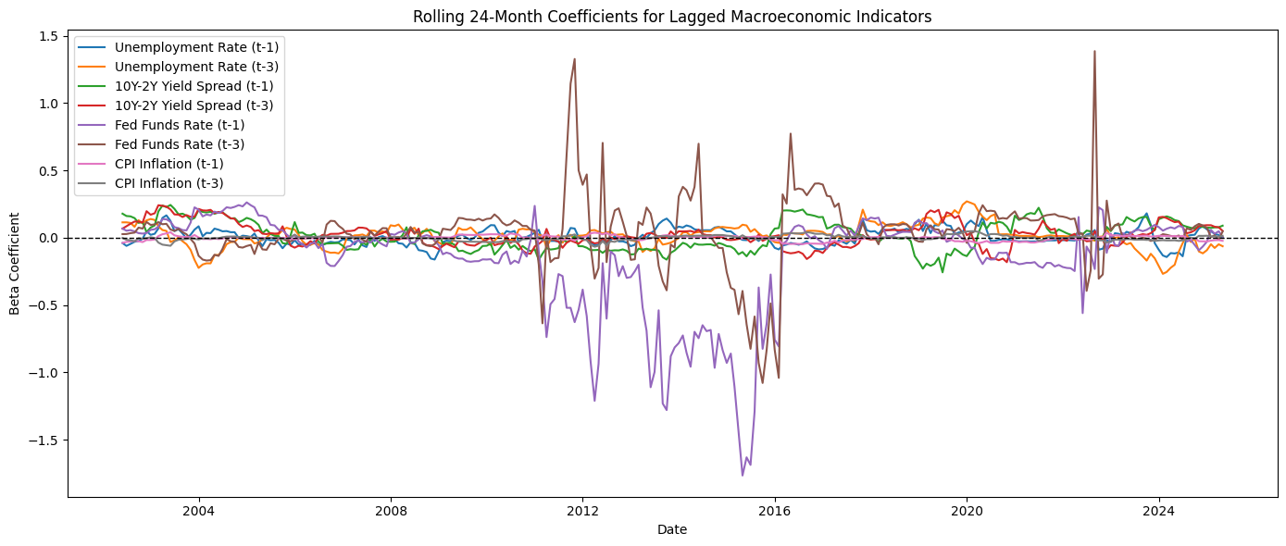
Rolling Window Analysis
24 Month Rolling Beta Regressions
Key Interpretations (t-1, t-3)
Unemployment Rate
Yield Spread
Fed Funds Rate
CPI
Overall Takeaways
Notes:
Beta > 1: The asset is more volatile than the market. For example, beta of 1.5 means if the market goes up 5%, the asset might go up 7.5%.
Beta < 1 (but > 0): The asset is less volatile than the market. A beta of 0.5 implies that if the market rises 5%, the asset might rise 2.5%.
Beta < 0: The asset moves opposite the market.

Slide 10
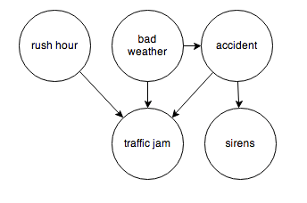
Granger Causality Test
We’re looking for an early warning (predictive) signal
P-Value <0.05 → Statistically significant predictive relationship
Key Findings
Investors adjust their behavior to monetary policy posted 3 and 4 months before with a delay
This may reflect the delayed effect of inflation expectations on equity risk premiums or Fed response
Variable | Lag | p-value | Interpretation
Fed Funds Rate (t-3) | 2 | 0.0244 | Predictive
CPI Inflation (t-3) | 2 | 0.0288 | Predictive
Unemployment (t-1, t-3) | 1–2 | 0.06–0.12 | Borderline
Yield Curve (t-1, t-3) | 1–3 | >0.5–0.9 | Not Predictive
CPI (t-1) | 3 | ~0.07 | Borderline
Notes:
Does past information about variable x help predict Y, beyond what past Y already tells us?
In this case, does a lagged Macro Variable help predict SPY returns?

Slide 11

Summary of Results
Statistical Relationships
Multivariable Regressions
Model as a whole did not have statistical significance
Indicators did not attribute much to SPY return variance
Too much correlation between predictors
Univariable Regressions
Little to no statistical significance across the board
Indicators did not have size &/or directional sensitivity
Indicators did not have explanatory relationship to SPY
Predictive relationships
Granger Causality test
Statistically significant predictive relationship between two of the eight variables and monthly SPY returns
Macro economic feasibility from results

Slide 12


Discussions & Conclusions
Economic Indicators & SPY Performance
Lagging and Feature Engineering (Plus Rolling Window Analysis)
Linear Regression and Multivariable Regression
Correlation of Different Indicating Variables (Predictive Rates)
Issues of Multicollinearity Between Indicating Variables
Granger Causality Tests
Complexity of Economic Indicators to Market Performance
Behavioral Economics (& Market Reactions to Expectations)
Lagging Effects
Market Psychology
Multiple Interrelated Indicators
Limitations of Research
Notes:
Lagging to see multi-period impact on indicator variables
Multi regression to see impact of multiple variables since individual was too weak for predictive power.

Slide 13






Sources

Slide 14
Q&A

